Slide 1
C++
Md. Abdur Rahman
Senior Computer Scientist
Centre for Advanced in Research in Sciences (CARS)
University of Dhaka

Slide 2
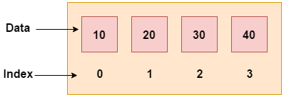
C++ Arrays
Array is a group of similar types of elements that have contiguous memory location
In C++ std::array is a container that encapsulates fixed size arrays.
In C++, array index starts from 0.
We can store only fixed set of elements in C++ array.

Slide 3
Advantages of C++ Array
Code Optimization (less code)
Random Access
Easy to traverse data
Easy to manipulate data
Easy to sort data etc.
Disadvantage of C++ Array
Fixed size

Slide 4
Single Dimensional Array
#include<iostream>
using namespace std;
int main()
{
int arr[5] = {10, 20, 30, 40, 50};
for(int i=0; i< 5; i++)
{
cout <<arr[i]<<"\n";
}
return 0;
}

Slide 5
Traversal using foreach loop
#include<iostream>
using namespace std;
int main()
{
int arr[5] = {10, 20, 30, 40, 50};
for(int i:arr) // iterate over array arr
cout <<i<<"\n"; // we access the array element for this iteration through variable i
return 0;
}
For-each loops
for (element_declaration : array)
statement;

Slide 6
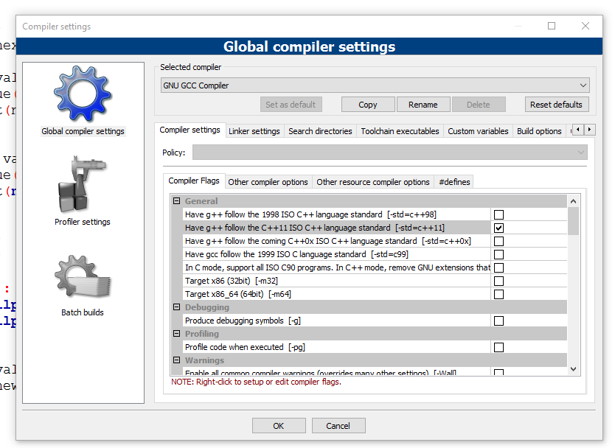
warning: range-based 'for' loops only available with -std=c++11 or -std=gnu++11

Slide 7
Passing Array to Function
#include<iostream>
using namespace std;
void printArray(int arr[5]);
int main()
{
int arr1[5] = {10, 20, 30, 40, 50};
int arr2[5] = {5, 15, 25, 35, 45};
printArray(arr1);
printArray(arr2);
}
void printArray(int arr[5])
{
for(int i=0; i<5; i++)
{
cout << arr[i] << "\n";
}
}

Slide 8
Print minimum number
#include<iostream>
using namespace std;
void printMin(int arr[5]);
int main()
{
int arr1[5] = {30, 20, 10, 40, 50};
int arr2[5] = {35, 15, 25, 5, 45};
printMin(arr1);
printMin(arr2);
}
void printMin(int arr[5])
{
int min = arr[0];
for(int i=0; i<5; i++)
{
if(min>arr[i])
{
min = arr[i];
}
}
cout <<"Min element is: " << min << "\n";
}

Slide 9
Print maximum number
#include<iostream>
using namespace std;
void printMax(int arr[5]);
int main()
{
int arr1[5] = {30, 80, 10, 40, 20};
int arr2[5] = {35, 45, 25, 15, 5};
printMax(arr1);
printMax(arr2);
}
void printMax(int arr[5])
{
int min = arr[0];
for(int i=0; i<5; i++)
{
if(min < arr[i])
{
min = arr[i];
}
}
cout <<"Max element is: " << min << "\n";
}

Slide 10
Multidimensional Array
The multidimensional array is also known as rectangular arrays in C++
The data is stored in tabular form (row ∗ column) which is also known as matrix.
Total number of elements that can be stored in a multidimensional array can be calculated by multiplying the size of all the dimensions.
int x[10][20] can store total (10*20) = 200 elements.
int x[5][10][20] can store total (5*10*20) = 1000 elements.

Slide 11
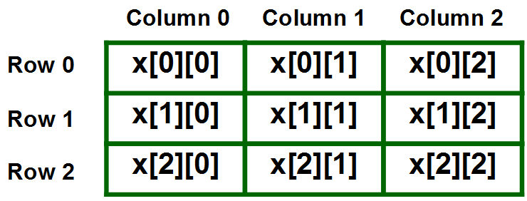
Two Dimensional Array
int x[3][3];

Slide 12
Two Dimensional Array
Initializing Two – Dimensional Arrays:
First Method:
int x[3][4] = {0, 1 ,2 ,3 ,4 , 5 , 6 , 7 , 8 , 9 , 10 , 11}
Better Method:
int x[3][4] = {{0,1,2,3}, {4,5,6,7}, {8,9,10,11}};

Slide 13
Two Dimensional Array
#include<iostream>
using namespace std;
int main()
{
int test[3][3]; //declaration of 2D array
test[0][0]=5; //initialization
test[0][1]=10;
test[1][1]=15;
test[1][2]=20;
test[2][0]=30;
test[2][2]=10;
//traversal
for(int i = 0; i < 3; ++i)
{
for(int j = 0; j < 3; ++j)
{
cout<< test[i][j]<<" ";
}
cout<<"\n"; //new line at each row
}
return 0;
}

Slide 14
Two Dimensional Array
#include<iostream>
using namespace std;
int main()
{
// an array with 3 rows and 2 columns.
int x[3][2] = {{0,1}, {2,3}, {4,5}};
// output each array element's value
for (int i = 0; i < 3; i++)
{
for (int j = 0; j < 2; j++)
{
cout << "Element at x[" << i
<< "][" << j << "]: ";
cout << x[i][j]<<endl;
}
}
return 0;
}

Slide 15
Two Dimensional Array
#include<iostream>
using namespace std;
int main()
{
int marr[3][3] =
{
{2, 5, 5}, {4, 0, 3}, {9, 1, 8}
};
for(int i=0; i< 3; i++)
{
for(int j=0; j<3; j++)
{
cout<<marr[i][j]<<"";
}
cout<<"\n"; // new line at each row
}
return 0;
}

Slide 16
Three Dimensional Array
Initialization in Three-Dimensional array is same as that of Two-dimensional arrays.
The difference is as the number of dimension increases so the number of nested braces will also increase.
int x[2][3][4] =
{
{ {0,1,2,3}, {4,5,6,7}, {8,9,10,11} },
{ {12,13,14,15}, {16,17,18,19}, {20,21,22,23} }
};

Slide 17
Three Dimensional Array
#include<iostream>
using namespace std;
int main()
{
int x[2][3][2] =
{
{ {0, 1},{2, 3}, {4, 5} },
{{6,7}, {8, 9}, {10, 11} }
};
for(int i=0; i<2; ++i)
{
for(int j=0; j<3; ++j)
{
for(int k=0; k<2; ++k)
{
cout << "Element at x[" << i << "][" << j << "][" << k << "] = " << x[i][j][k] <<endl;
}
}
}
return 0;
}

Slide 18
#include<iostream>
using namespace std;
void sum(int, int);
int main(){
int row, col;
cout<<"Enter the number of rows: ";
cin>>row;
cout<<"Enter the number of column: ";
cin>>col;
sum(row, col);
return 0;
}
void sum(int r, int c){
int m1[r][c], m2[r][c], s[r][c];
cout << "Enter 1st matrix: ";
for (int i = 0; i<r; i++) {
for (int j = 0; j<c; j++) {
cin>>m1[i][j];
}
}
cout << "Enter 2nd matrix: ";
for (int i = 0;i<r;i++ ) {
for (int j = 0;j<c;j++ ) {
cin>>m2[i][j];
}
}
cout<<"Output: ";
for (int i=0; i<r; i++) {
for (int j=0; j<c; j++) {
s[i][j] = m1[i][j] + m2[i][j];
cout<<s[i][j]<<" ";
}
}
}

